Slide 1
Probabilistic Modeling of Neural Data
Elom Amematsro & Amin Nejatbakhsh

Slide 2
Motivation
Probability Review
Graphical Models
Probabilistic Programing
Examples

Slide 3
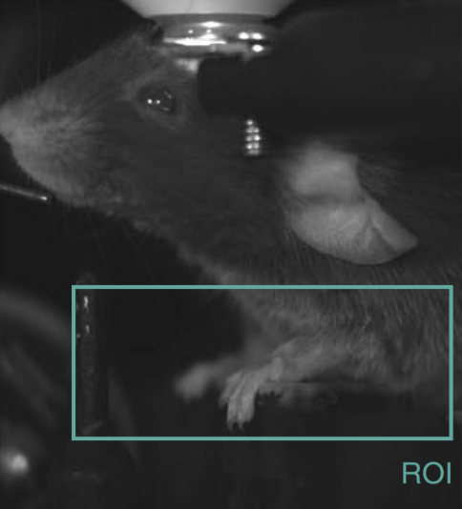
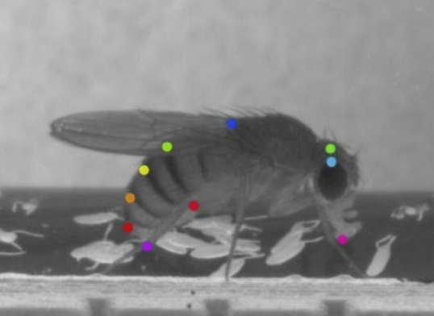
Data in neuroscience
Mathis et al, 2018

Slide 4
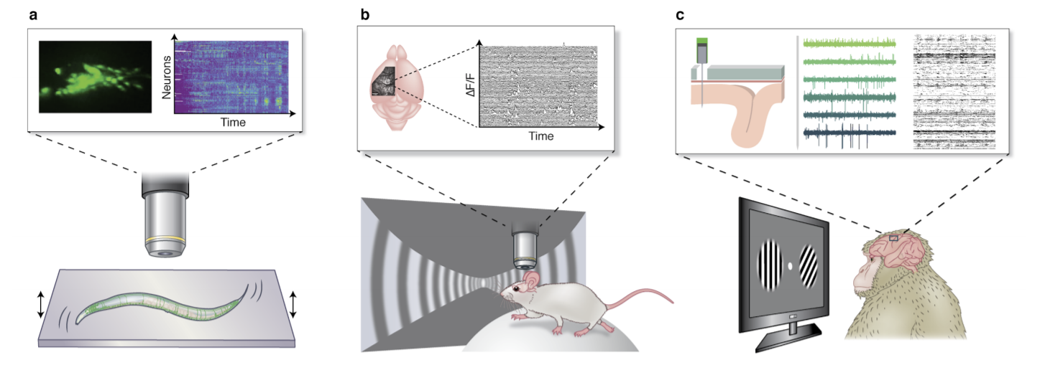
Data in neuroscience
Urai et al, 2021

Slide 5
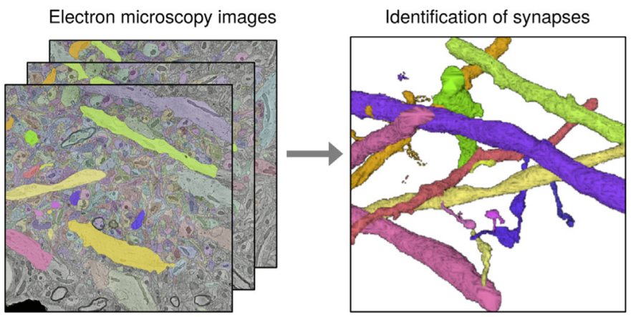
Data in neuroscience
Litwin-Kumar 2019
What data do you work with?

Slide 6
Data in neuroscience is complex
High dimensional
Images or videos, recordings from many neurons
Dynamic, functions of time
Interacting nodes
In the level of proteins, cells, regions, etc.
Multiple levels
Proteins and genes > Cell organelles > Single neuron morphology and function > Dendritic and axonal computations > Neural circuits > Brain regions > Behavior
What other complexity can you think of?

Slide 7
Data in neuroscience is complex
Our goal is to make sense of data
Find hidden structure
Understand mechanisms
Make predictions
Test and generate neural hypotheses

Slide 8
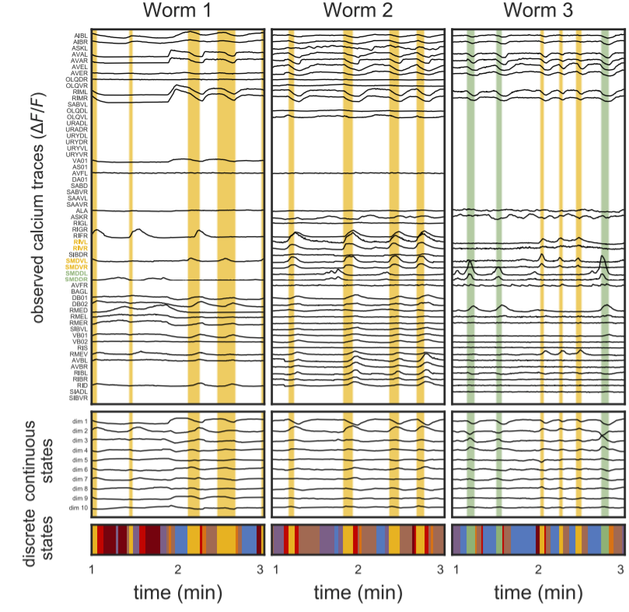
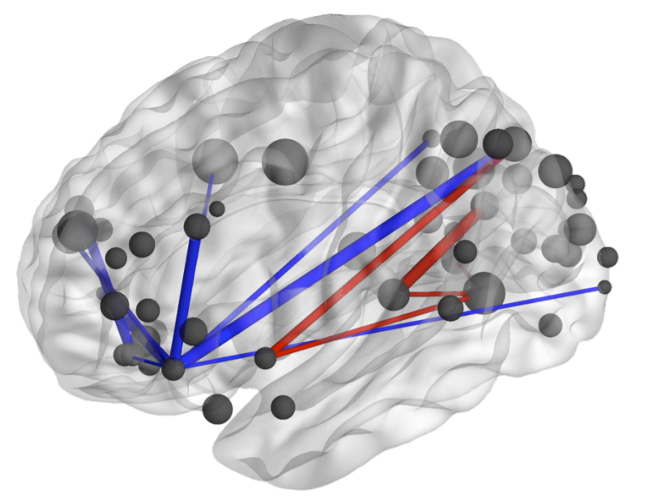
Find hidden structure
Time segmentation of neural activity and behavior
Information flow, functional connectivity
Manning et al, 2014
Linderman et al, 2019

Slide 9
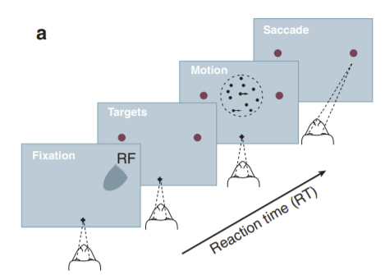
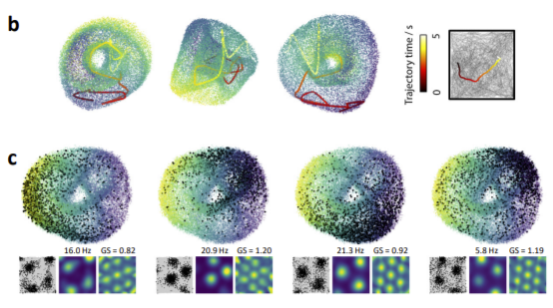
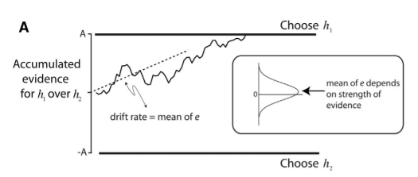
Find hidden structure
Decision variable
Low-dimensional neural manifold
Gardner et al, 2021
Other hidden structures: Interaction subspace, Spatial and temporal components in videos, Spike times from voltage recordings, Behavioral syllabi, Memory footprints, Atlas of C. elegans neural positions, Toroidal topology of population activity in grid cells, Brain “states”, Vesicle release probability, Cognitive maps, Neural morphology branch factors
Shadlen et al, 2016

Slide 10
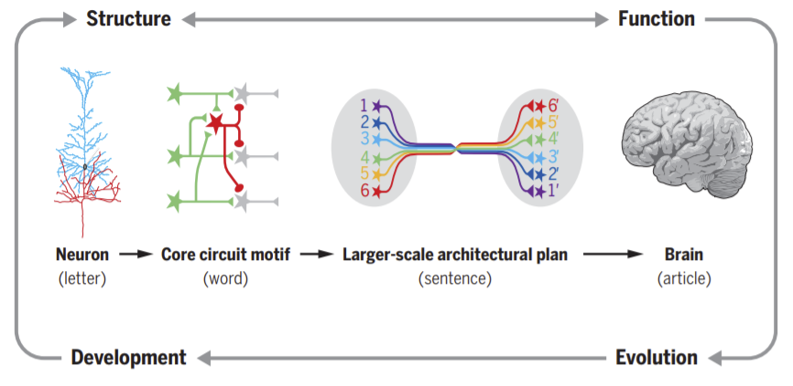
Understand mechanisms
From genes to behavior
Luo, 2021

Slide 11
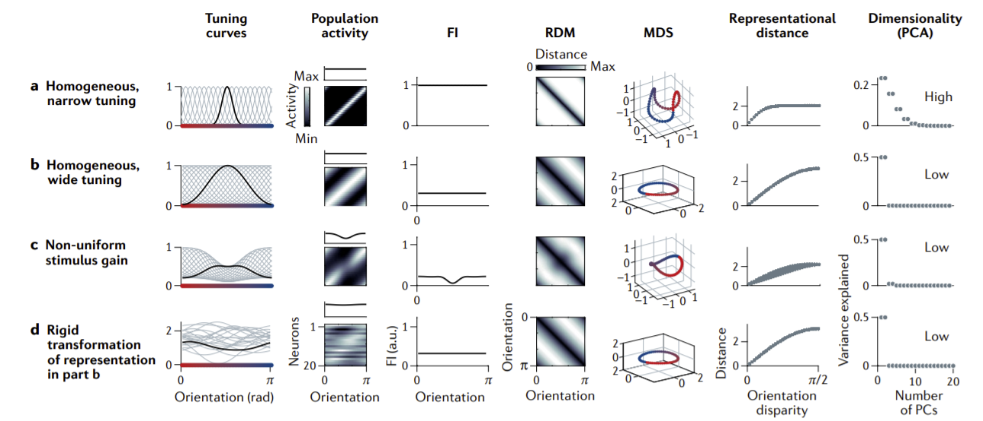
Understand mechanisms
Neural tuning curves and representational geometry
Kriegeskorte et al, 2021

Slide 12
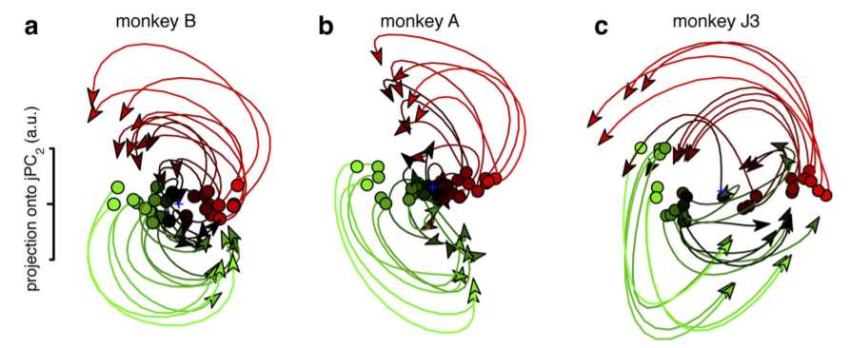
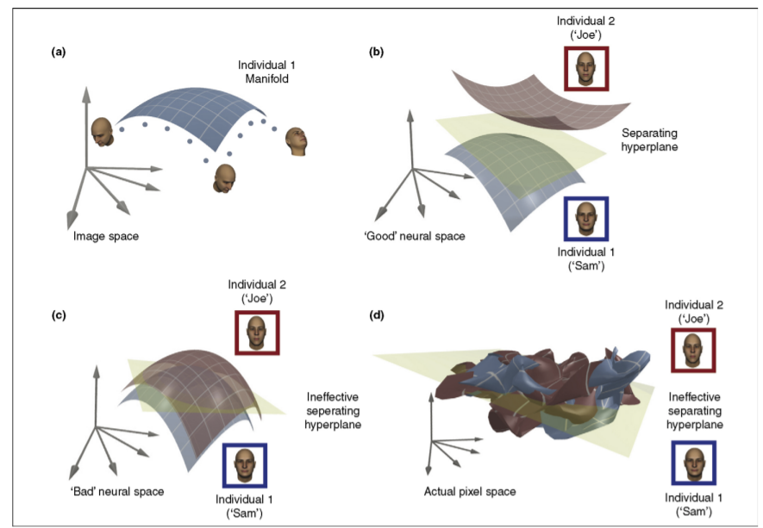
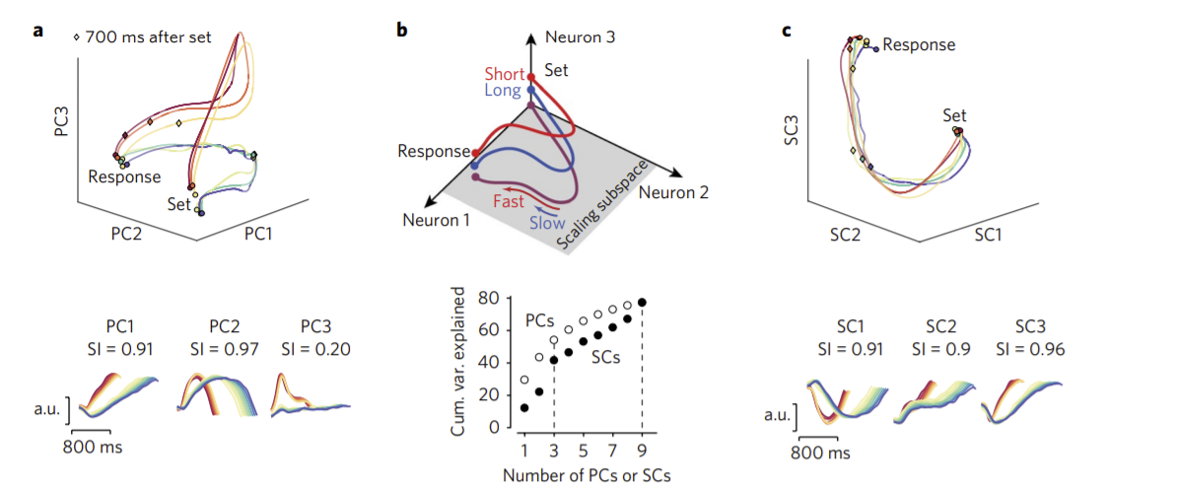
Understand mechanisms
Neural representation of muscle commands
Neural representation of faces
Churchland et al, 2012
Neural representation of time
DiCarlo et al, 2007
Other mechanisms: Dynamical properties (metastability, chaos, attractors, limit cycles), Role of neuron subtypes, Untangling motor cortex, Neuro-behavior correspondence , Learning rule (Hebbian, reward-based, contrastive, supervised)
Wang et al, 2018

Slide 13
Make predictions
Response to perturbation and lesion, causal prediction
Regression on task variables, predicting response to new variables
Predicting how to stop epileptic seizures
Missing data imputation
Test and generate neural hypotheses
Predictive coding
Maximum entropy
Significance testing, bootstrapping
What question are you trying to answer?

Slide 14
Approaches in data analysis
Top down: start from a high level hypotheses (e.g. hippocampus uses BFS algorithm!) and find neural evidence for it
Bottom up: purely data driven
Statistical machine learning allows us to build models covering the spectrum between bottom up and top down approaches
Use prior knowledge where it exists
Learn from data where it doesn’t
Advantages of statistical machine learning
Allows for incorporating domain knowledge into the model
Provides computational practices for estimating variables of interest
Expressive, scalable, and easy to develop

Slide 15
Motivation
Probability Review
Graphical Models
Probabilistic Programing
Examples

Slide 17
Joints and Marginals
Uncertainty
Useful Distributions

Slide 18
Joint and Marginal Distribution
Lab Reared
Wild Type
Total
Octanol
265 | 84 | 349
83 | 14 | 97
129 | 33 | 162
477 | 131 | 608
Geosmin
Cis-vacenyl acetate
Total

Slide 19
Joint and Marginal Distribution
Lab Reared
Wild Type
Total
Octanol
0.44 | 0.14 | .57
0.14 | 0.02 | .16
0.21 | 0.05 | .27
.78 | .22 | 1
Geosmin
Cis-vacenyl acetate
Total

Slide 20
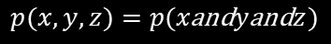
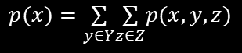
Joint and Marginal Distribution
Joint probability:
$$p(x,y,z)=p(x\text{and}y\text{and}z)$$
What is the probability of a fly being wild-type and selecting octanol?
Marginal probability:
$$p(x)=\underset{y∈Y}{∑}\underset{z∈Z}{∑}p(x,y,z)$$
What is the probability of a fly selecting octanol?

Slide 21
Joint and Marginal Distribution
Lab Reared
Wild Type
Total
0.44 | 0.14 | .57
0.14 | 0.02 | .16
0.21 | 0.05 | .27
.78 | .22 | 1
Octanol
Geosmin
Cis-vacenyl acetate
Total

Slide 22
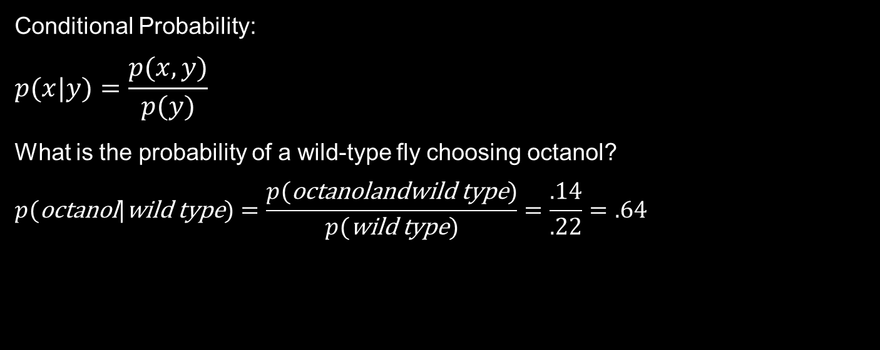
Conditional Probability
Conditional Probability:
$$p(x|y)=\frac{p(x,y)}{p(y)}$$
What is the probability of a wild-type fly choosing octanol?
$$p(\text{octanol}|\text{wild} \text{type})=\frac{p(\text{octanolandwild} \text{type})}{p(\text{wild} \text{type})}=\frac{.14}{.22}=.64$$

Slide 23
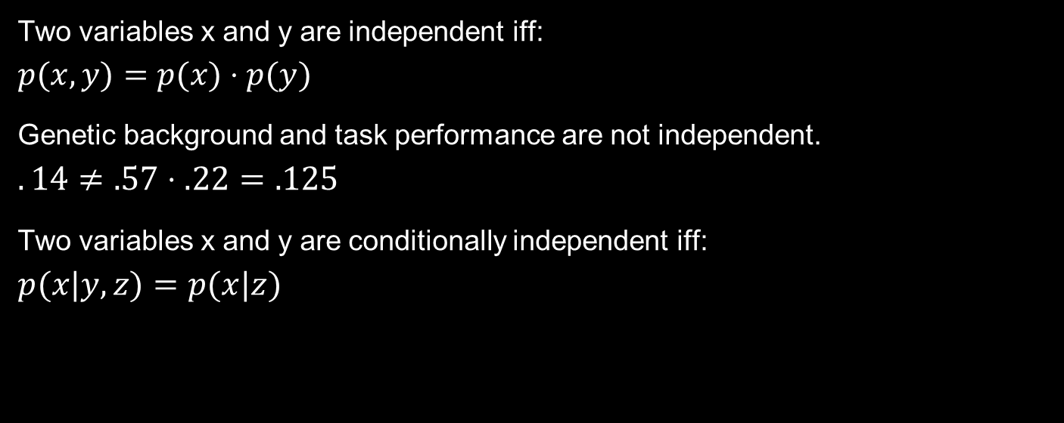
Independence
Two variables x and y are independent iff:
$$p(x,y)=p(x)⋅p(y)$$
Genetic background and task performance are not independent.
$$.14≠.57⋅.22=.125$$
Two variables x and y are conditionally independent iff:
$$p(x|y,z)=p(x|z)$$

Slide 24
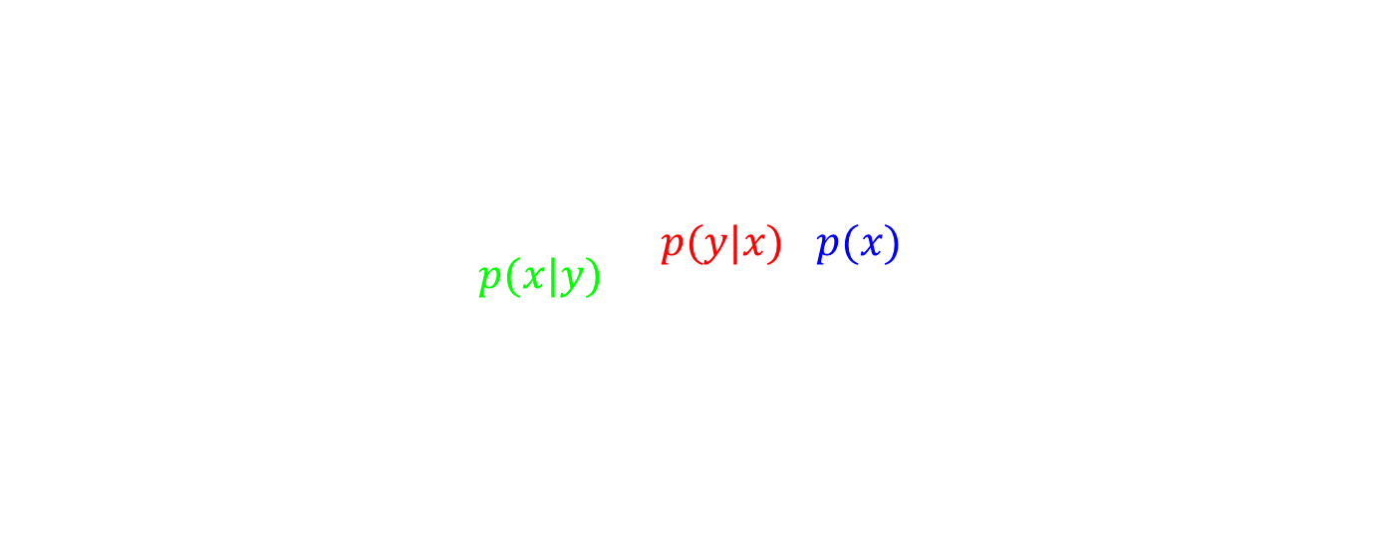
Bayes’ Rule
$$p(x|y)=\frac{p(x,y)}{p(y)}$$
$$p(x,y)=p(y,x)⋅p(x)$$
$$p(x|y)=\frac{p(y|x)⋅p(x)}{p(y)}$$

Slide 25
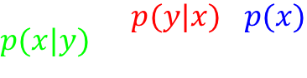
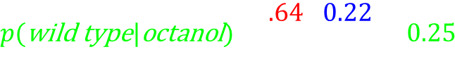
Bayes’ Rule
$$p(x|y)=\frac{p(y|x)⋅p(x)}{p(y)}$$
$$p(\text{wild} \text{type}|\text{octanol})=\frac{p(\text{octanol}|\text{wild} \text{type})⋅p(\text{wild} \text{type})}{p(\text{octanol})}$$
$$p(\text{wild} \text{type}|\text{octanol})=\frac{.64⋅0.22}{.57}=0.25$$

Slide 27
Directed Graphs
Parent Rule
Distributions
Box’s Loop

Slide 28
Directed Graphs

Slide 29
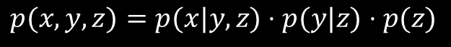
Directed Graphs
Consist of nodes (random variables) and edges (relationships between variables).
x
y
z
$$p(x,y,z)=p(x|y,z)⋅p(y|z)⋅p(z)$$

Slide 30
Directed Graphs
X
Y
X
Y
Z
Z
X
Y
Z

Slide 31
Parent Rule
Parents: All nodes that point to the current node.
X and Y are parents of Z.
Children: All nodes that the node points to.
Z and Y are children of X.
x
y
z

Slide 32
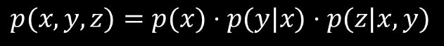
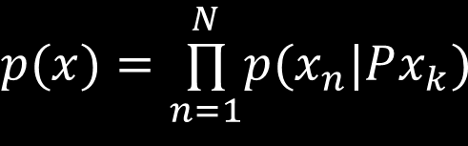
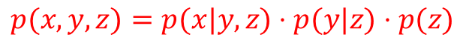
Parent Rule
$$p(x)=\overset{N}{\underset{n=1}{∏}}p(x_{n}|Px_{k})$$
x
y
$$p(x,y,z)=p(x)⋅p(y|x)⋅p(z|x,y)$$
$$p(x,y,z)=p(x|y,z)⋅p(y|z)⋅p(z)$$
z

Slide 33
Parent Rule
1
3
2
4
6
5
7
$$p(x)=p(1)⋅p(3)⋅p(2|3)⋅p(5|6)⋅p(6|1)⋅p(4|1,2)⋅p7(4,3)$$

Slide 34
Distributions
Discrete:
Bernoulli
Dirichlet
Count process:
Binomial
Poisson
Multinomial
Continuous:
Beta
Exponential
Gamma
Gaussian
Uniform

Slide 35
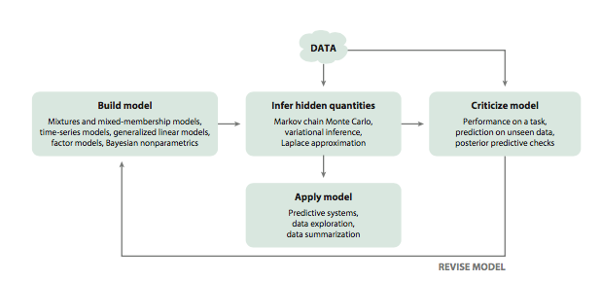
Box’s Loop

Slide 36
Variational Inference

Slide 38
From Pyro.ai
Universal
can represent any computable probability distribution.
Scalable
scales to large data sets with little overhead
Minimal
is implemented with a small core of powerful, composable abstractions
Flexible
aims for automation when you want it, control when you need it

Slide 39
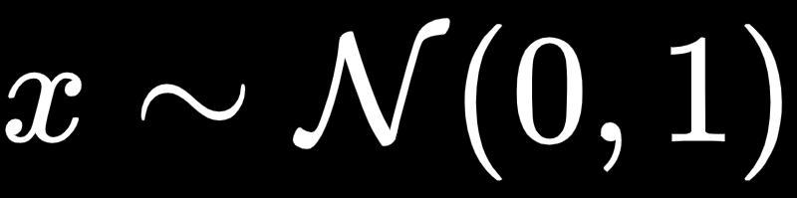
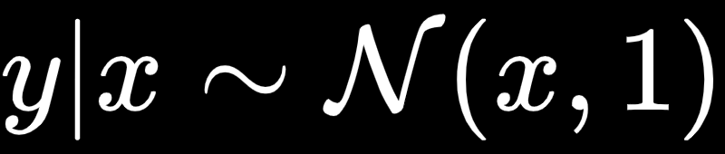
Basics of Pyro
Sampling
Conditioning on data
x = dist.Normal(0,1).sample()
y = dist.Normal(x,1).sample()
pyro.sample("obs",dist.Normal(mean,sigma),obs=data)
Conditional independence
with pyro.plate("data", len(data)):
return pyro.sample("obs",dist.Normal(mean,sigma),obs=data)
Parameters and constraints
sigma = pyro.param("sigma", lambda: torch.ones(()), constraint=constraints.positive)

Slide 40
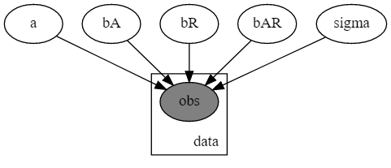
Basics of Pyro
a = pyro.sample("a", dist.Normal(0., 10.))
b_a = pyro.sample("bA", dist.Normal(0., 1.))
b_r = pyro.sample("bR", dist.Normal(0., 1.))
b_ar = pyro.sample("bAR", dist.Normal(0., 1.))
sigma = pyro.sample("sigma", dist.Uniform(0., 10.))
mean = a + b_a*is_cont_africa + b_r*ruggedness + b_ar*is_cont_africa*ruggedness
with pyro.plate("data", len(ruggedness)):
return pyro.sample("obs", dist.Normal(mean, sigma), obs=log_gdp)

